Slide 1
Job Hunting Strategy
Career Development Recommendation
Cheng-chun Chao
Sean Chuang
Xinyu Wang
Yijun Liang
Yuanyuan Xiao

Slide 2





Job Hunting
can be quite frustrating
Resume
Knowledge
Skills
Salary
Accessed 2020, https://nypost.com/2018/07/08/if-job-stress-is-killing-you-its-time-to-leave/

Slide 3



Career Development Recommendation Engine
Potential Users:
People who are looking for job, especially students or fresh graduate
Company HR or Staffing Agents
How does our product can help:
For Job Hunters:
Find suitable jobs based on their current skill sets
What skills are needed for the recommended jobs
What is a reasonable salary range to ask
For HR:
Learn about what kind of skills candidates need to have
Job Hunter’s Statistics
Recommendation
Algorithm
Suggested Job Positions & Related Information

Slide 4






Job Hunting Strategy - Career Development Recommendation
Job Recommendation within Machine Learning & Data Science Field
Minimum Viable Product：
Approaches
Kaggle
Dataset
Models
Web Scraping
Additional learning opportunities
User Interface
User-friendly operations platform
Output
User Tailored Information
Job Recommendation
Salary Prediction
Interactive experience
Visualize results
Books & Courses

Slide 5
Demo
Demo video uploaded to google drive shared folder due to file size:
https://drive.google.com/open?id=1fokEpupjr2fY6iOeQ3BheEuTnyjQijR8

Slide 6
Approach

Slide 7
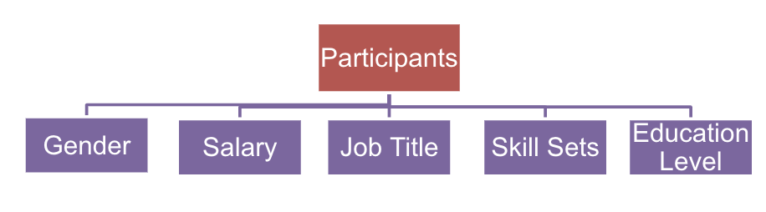



Data Wrangling
Data Source:
Kaggle 2019 Survey – 3500+ observations
Supplementary Web Scraping Data
Coursera Online Courses – Easily accessed courses for recommended skills (for all students)
Berkeley Library Books – Educational books recommendation for Berkeley students
PayScale Skill Sets (pending) – Popular skills for job titles
＆
Main data (raw + plain text)
Supporting web scraping data
Notes:
skillset web scraping ?

Slide 8
Data Cleaning
Unification
Explanatory analysis
Feature selection
Imputation
Aggregation
Encoding
Unstructured (plain-text)
Irrelevant data
Redundant features
Missing values
Outliers
Preprocess
Notes:
For the data cleaning part, we aim to combine data set acquired from different sources, and then select important features for our machine learning model. During the process, there are several issues need to be solved, unstructured and excessive features are the main problems we focus on. It is because our data are derived from plain text survey and it includes numerous multiple choice questions and we have around 100 features in total.
So we take steps to deal with the problem mentioned in the slide, including data aggregation and feature selection to reduce the number of features. And we clean out those data containing too much NA values. And impute the rest of them with guess matrix, either the mode or average value. Last, we encode and convert the plain-text response into either numbers or categorical variables for further analysis.

Slide 9
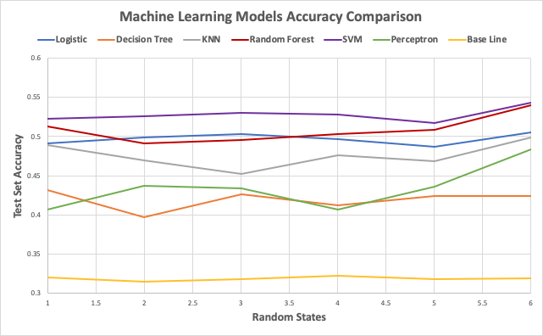
Model Selection
SVM has highest accuracy.
20% more accurate than baseline model.
Output top three job categories ranked by prediction probability.
Predicted job titles are used to predict salary range.

Slide 10
Summary

Slide 11


Our Learning Path
Structure User input V Model V Display
Modeling - Recommendation Netflix use case – collaborative filtering
Modeling - Building Data Cleaning Evaluate Performance Model Comparison
Modeling - Classification SVM, Logistic, Random Forest…
Data Collection Kaggle Web Scraping Data
Web Application - Tools Out-of-the-box solution - WIX
Web Application -Content Record User Input Model blending Display organized result Web Design Error Handling
Web Application - Tools Python-Flask
Icon Accessed 2020, web application by Evgeniy Kozachenko from the Noun Project

Slide 12
Project GitHub Link: https://github.com/joliang17/DataX_Project

